Slide 1
Graphene on paper based sensor for estimation of respiration rate
Required Components:
Sensor-(Graphene embedded on paper): This emerging demand has led to the rapid development of paper-based electronics, the various advantages of paper such as low cost, biodegradability, sustainability and flexibility.
Signal Conditioning Circuit(Build based on second order bandpass filter): This is used to amplify the signal and cancel the noise.
Signal processing Circuit( ESP8266 Node MCU): Use to process the signals and calculate the respiration rate and send a alert message to WhatsApp if respiration rate is crossing the threshold.
Alert messages through WhatsApp

Slide 2
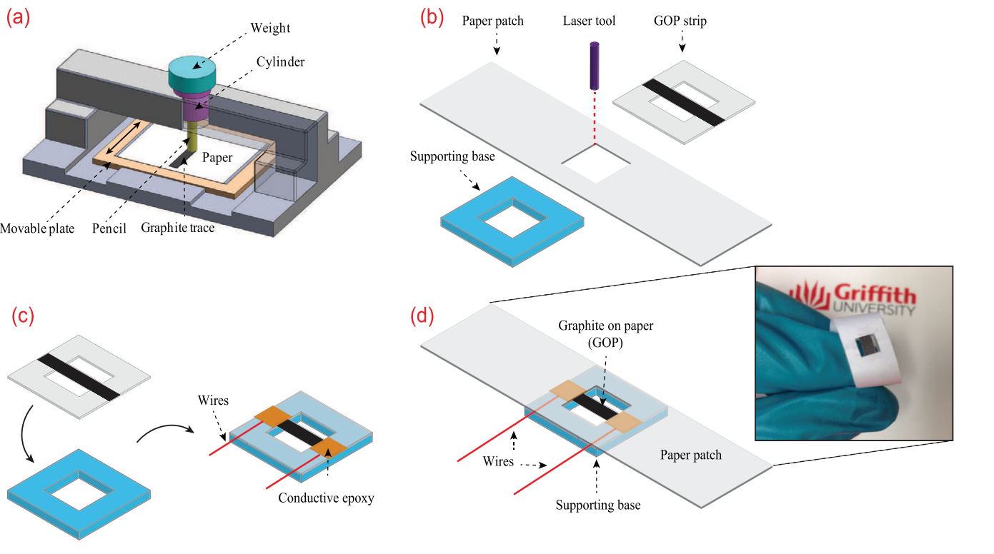
Sensor:
Reference: https://doi.org/10.1088/1361-6463/aa6cd6

Slide 3

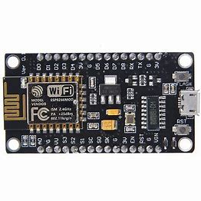
Flexible Circuit
RIGID Circuit
SENSOR
Signal Conditioning
Circuit

